Slide 1
Examination
of
Tool Marks
ranbsingh

Slide 2
Tool Marks
- interaction of two objects: harder of the two
leaves marks on the softer
Tools are often used in the commission of crimes like house breaking, car thefts, illegal cutting of wires/cables, etc
Tool marks are examined to
- link the criminal with the crime
- for reconstruction of crime
Tools
Single stroke or one time application
Repeated strokes or multiple applications
ranbsingh

Slide 3
Tool marks may be:
Impressed/Static/Compression/Indentation marks
Striated/Dynamic/Scrape marks
Combination of Static and Dynamic marks
Crushed marks
Repetitive/Multi-stroke marks
Other type of marks involving similar principles:
Prints (printing blocks, numbering and dating machines)
Contact marks
Broken and severed parts
ranbsingh

Slide 4
Location
Location of the tool marks depends upon the nature of crime.
Rubber cables and hosepipes do not retain identifiable tool marks. They can not be identified in respect of tools in most of the cases. The type of cutter used can be indicated sometimes.
The tool marks are ordinarily visible as such. However, scratches in wood, paint, and the like may need oblique torch light and semi dark place.
If the climate is humid and hot a tool or tool mark on a metal article may rust. The mark may get obliterated.
A thin oil film is applied over the surface to prevent rusting.
ranbsingh

Slide 5
Collection of tools/tool marks
Pack tools in cardboard boxes securely, to avoid any damage in transit. Cotton wool is not preferred, trace evidence may be lost
Record the tool marks: photograph/sketches/notes
Look for trace evidence (loose material)
Protect the marks
Collect the original object bearing the tool marks, if convenient. If the article is too big for convenient handling, the mark bearing portion may be cut and separated.
If collection of the article or part thereof, bearing the mark is not possible, cast of the mark is made
ranbsingh

Slide 6
Desirable Properties of Casting material
the casting material should
Record fine details
Be dimensionally stable
Be easily prepared
Set fairly quickly
The final cast should be robust
A cast or mould is simply a reverse or negative
three-dimensional image of an impression
ranbsingh

Slide 7
Some of the casting techniques are given below:
Plasticine:
Ordinary plasticine does not pickup fine details and are easily deformed. However, now good quality plasticine are available that can pickup fine details.
A lump of plasticine is taken and pressed in between two glass plates to give its smooth surface.
The slightly moistened smooth area is pressed against the mark. The moistened plasticine does not stick to the surface and picks up the details.
Dental Mass:
Dental mass can pick up fine details and record the marks permanently.
ranbsingh

Slide 8
Dental Mass (contd.)
The material is kneaded under hot water and when it is soft and uniform in texture, it is pressed between two glass plates to give smooth surfaces.
The material, while still warm, is pressed against the tool marks and left at the site for some time. It picks up the marks and then becomes hard.
Adhesive tape:
Adhesive tape used to lift fingerprints can be used to lift shallow tool marks. It does not give good results in deep scrapes and indentations.
ranbsingh

Slide 9
Latex, plastic solutions, Cellulose acetate etc:
Latex is rubber juice and is useful to collect tool marks. It is good material for scrape marks but is not so good for indentations especially deep ones, as due to stretching, the dimensions of the lifted marks change.
The material is poured over the surface bearing marks. It is then allowed to dry for about six hours. The thin film or sheet is pealed off.
The plastic solutions are equally useful to lift the marks and are processed in a similar way.
Tool marks from stone, concrete, wood, etc. can be lifted by cellulose acetate dissolved in acetone. A layer of 1/16 inch is made. The cellulose acetate cast should be photographed, with scale, immediately otherwise the layer is likely to shrink.
ranbsingh

Slide 10
Wood’s Metal:
This is an alloy, which melts at low temperature (71ºC). Its composition by weight is Bismuth 50%, Lead 25%, Tin 12.5% and Cadmium 12.5%.
It is used for indentations with appreciable depth on metal surfaces. The alloy is melted and poured into the mark. It solidifies on cooling and picks the details from the mark.
Plaster of Paris: (partly hydrated calcium sulphate)
It is useful when the impression is of large size and dimensions of the tool marks are important. The material is not so good to pick up the finer details.
ranbsingh

Slide 11
Examination of foreign material/materials on Tool
The suspected tool is examined for presence of all traces of metal, paint, wood, and foreign particles sticking to the tool/blade using the stereo microscope. The physical and chemical characteristics of these particles should be compared with the material of the surface on which the tool mark was made.
Test marks/Standards
Test tool marks are prepared preferably using similar material in which the tool marks were found at site. If the material is hard, sample marks are prepared in softer material. In place of steel, iron, brass, or copper, sheets of lead, zinc, tin, or aluminum are used to prepare test marks.
ranbsingh

Slide 12
Test marks/Standards (contd.)
The whole working surface of the tool is used to obtain complete
set of marks from the questioned tool. Test marks from all possible surfaces of the tool should be made, for example a screwdriver has two surfaces.
The angle at which the tool is applied has an important bearing on the dimensions of the scrape marks. A number of sample marks are obtained by changing the angle of application of the tool by about 15⁰ for each sample.
Trial sample marks should be taken on a much simpler material e.g. plasticine, when the most suitable angle is discovered, the sample marks are obtained on the material corresponding to the original material.
More than one test mark (say, three) is necessary to study range of variation
ranbsingh

Slide 13
Characteristic Features of Tool Marks
Class Characteristics:
features present in all tools of a particular type
Sub class characteristics:
features present in some tools of a particular type
Individual characteristics:
features produced in manufacture and by use due to wear and tear. Unique identification marks
ranbsingh

Slide 14
Examination of tool mark
Record the appearance of the tool mark
-photographs and sketches
Examine for trace evidence
-paint, glass, grease, oil, fragments of metal and wood etc
Examine under stereo microscope (low magnification)
-class characteristics and unusual features
Examine under comparison microscope
-compare ‘like with like’ i.e. tool and a cast of the mark or mark and a test mark made by the tool, or photograph with the photograph
ranbsingh

Slide 15
Evaluation
Comparison Microscopy:
Illumination and orientation of the two objects must be as near
identical as possible.
Oblique illumination: best for striated marks
Axial illumination: impressed marks/ die stamping; having flat surface
ranbsingh

Slide 16
Side by side match:
Photographs of indentions, punch marks, and prints from blocks, dating and punching machines are compared by placing them side by side.
Main points of defects and wear and tear, their sizes, shapes, and inter-distances are examined and compared.
Transparent graph sheet is used to facilitate comparison.
Juxtaposition match:
The photographs of the test and questioned marks are cut at the appropriate places and pasted in position to show match.
ranbsingh

Slide 17
Photographic Superimposition:
print is prepared from one of the marks; and transparency is prepared from the other mark.
photograph and the transparency are made of the same magnification or reductions
match is studied by placing the transparency over the photographic print.
Otherwise test mark is printed on an adhesive transparent plastic sheet. The test mark is now like a transparency.
If necessary, the contrast can be increased by using a suitable fingerprint powder over the tool.
ranbsingh

Slide 18
Striagraphy:
Study of the contour striations on different objects.
A delicate probe (stylus, laser) moves over the surface being studied.
The changes in depths and elevations are accentuated.
The comparison of the graphs indicates the identity or non identity
Automated Comparison:
Automated systems are available for comparison of marks bullets and cartridges cases.
ranbsingh

Slide 19
Saw marks
Saw marks including hacksaw marks are class by themselves. They do not permit identification of the tool except in rare cases. When the whole length is not cut through, saw or the hacksaw leaves at the bottom of the cut the pattern of the cutting surface. It indicates the number of teeth per unit length. If some teeth are broken their number, position and shape may allow positive identification of the saw or hacksaw.
Drill hole
Holes dug by drills and bits in wood are frequently useless for identification purposes. If the is not through and through, the bottom of the hole caries the indentation of the surface of the tool. A positive identification of this indentation in respect of the tool may sometimes be possible.
ranbsingh

Slide 20
Punched hole
Punched hole on a metal sheet (e.g. a tin openers hole in a can) are often identifiable in respect of the tool causing the hole because the tool leaves scrape marks on the can.
Contact marks
Articles which are joint together by glue, nails or rivets exchange contact marks, if they are detached changed or stolen. The fact that they were originally attached can be established from the presence of the contact marks. A stolen tire or detached license plate of vehicle or an ornamental piece fitted to vehicle and fallen off in an accident is identifiable in respect of the vehicle.
ranbsingh

Slide 21
Matching
Matching of individual striations are not important
Matching of sequence (runs) of striations should be considered
Texture of the surface should also be considered
The criteria convincing match is drawn from experience and common sense. It is a matter of skill acquired through practice
Under no circumstances one should attempt to fit the suspect tool into the tool mark
ranbsingh

Slide 22
Reporting
Basic Principle
Individualization is based upon the concept that the marks are the products of randomly occurring defects and the probability of two different objects having exactly the same defects is so small that it is non existent. However, the technique of comparison is subjective. The experience of an expert is an important guide in this respect.
In indentations even a single characteristic formation may be sufficient. The clarity of indentations depends upon the surface of the tool, the force of the impact, and nature of the recipient surface
In scrape marks, one should be careful against being misled by accidental match of a few lines
ranbsingh

Slide 23
Conclusions :
In general, the following conclusions may be reached
Comparison is not possible
- The tool or the mark are damaged
Result is inconclusive
- Agreement of class characteristics
- Insufficient discernible individual characteristics
Elimination
- Class and/or individual characteristics are different
- Caution: variations to be kept in mind
Identification
- Class characteristics are same
- Individual characteristics show no significant difference
- Individual characteristics are sufficient for comparison
ranbsingh

Slide 24
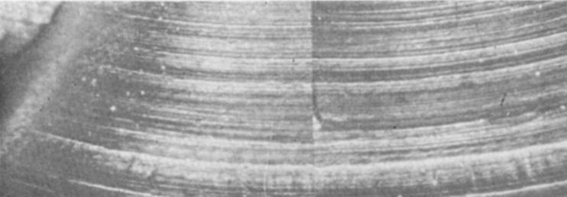
stolen scrap metal
from workshop
Comparison of turning striations
ranbsingh

Slide 25
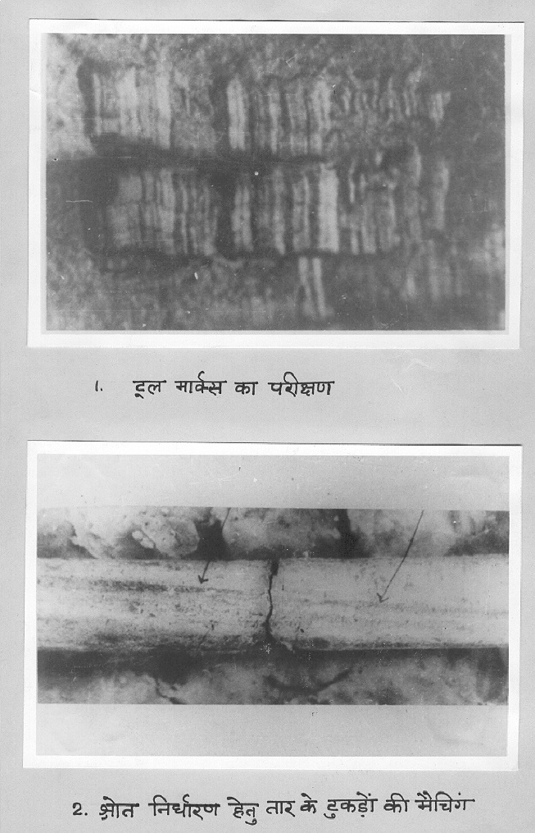
Comparison of tool marks
Matching of cut ends and die marks to determine source correspondence
ranbsingh

Slide 26
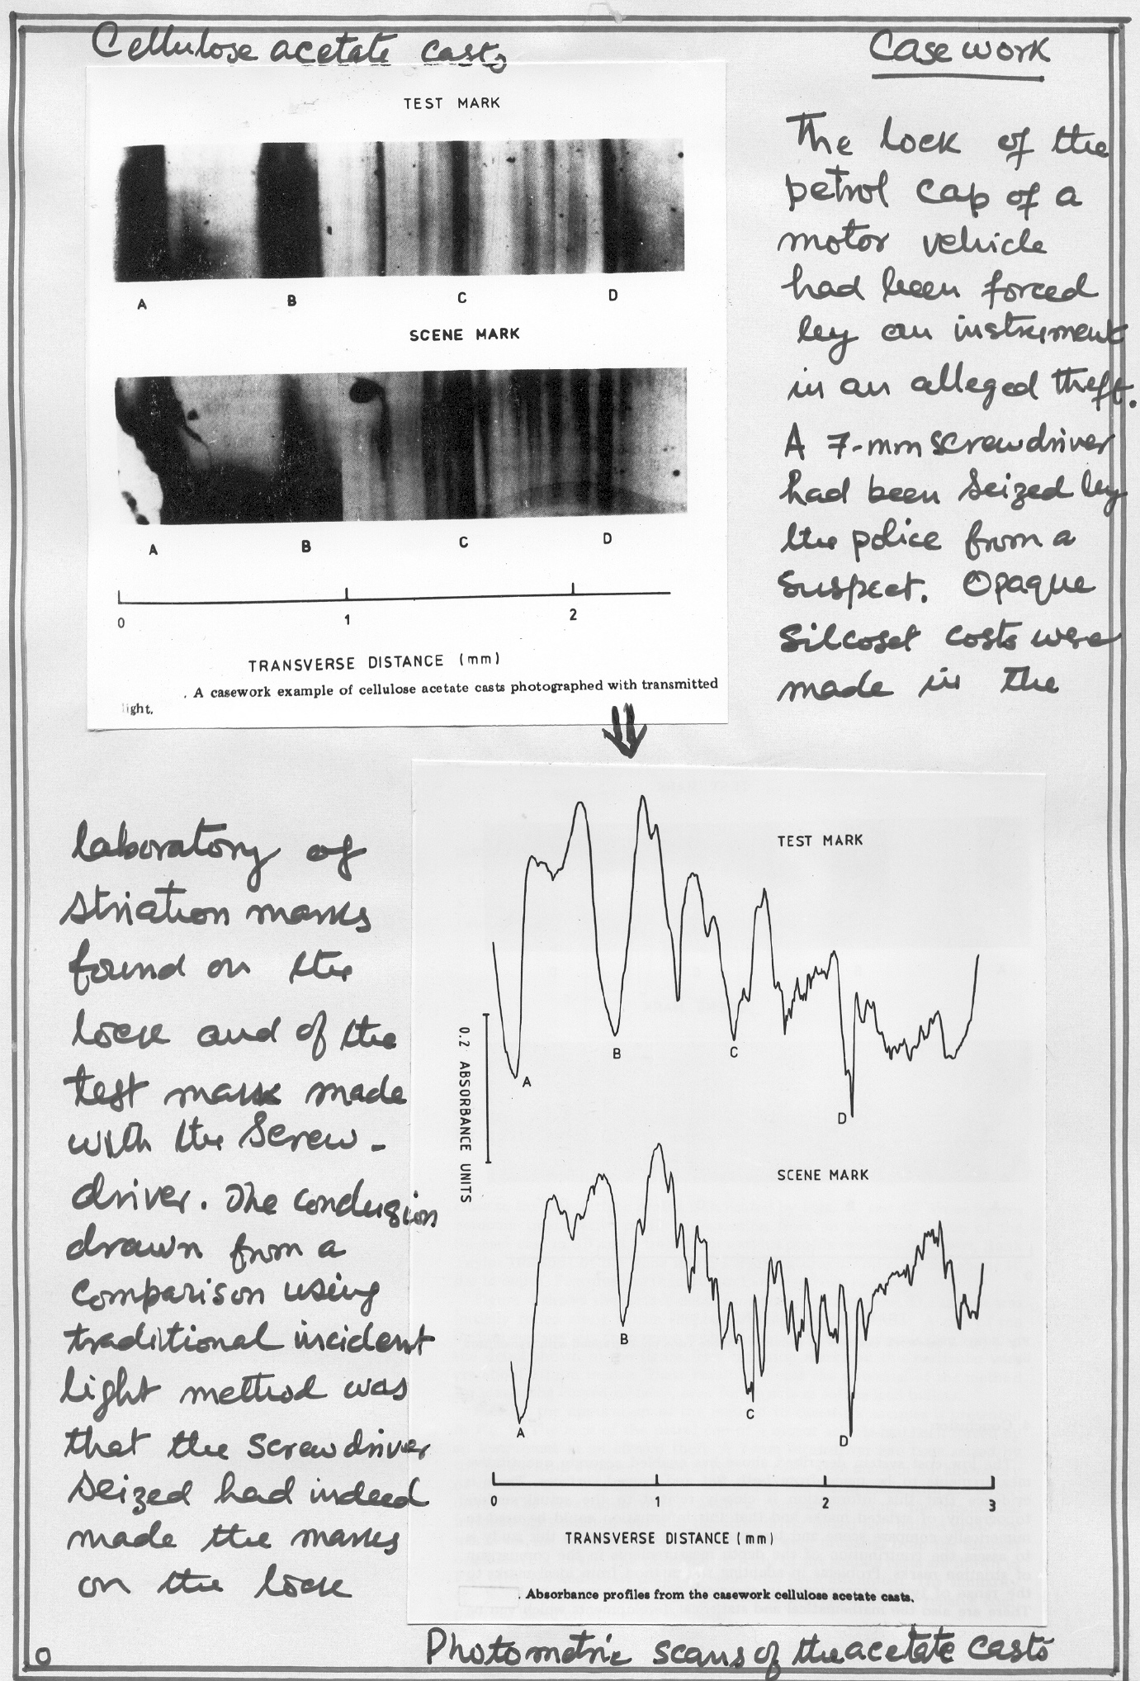
-Lock of petrol cap of a vehicle
was forced open
-A 7mm screwdriver was
seized from the suspect
Cellulose acetate casts of
-striations on the lock; and
-the test mark made with the
screwdriver
were made and were compared
-the screwdriver was linked to
the tool mark on the lock
photograph with transmitted light
Photometric scan of the casts
– absorption profile
ranbsingh

Slide 27
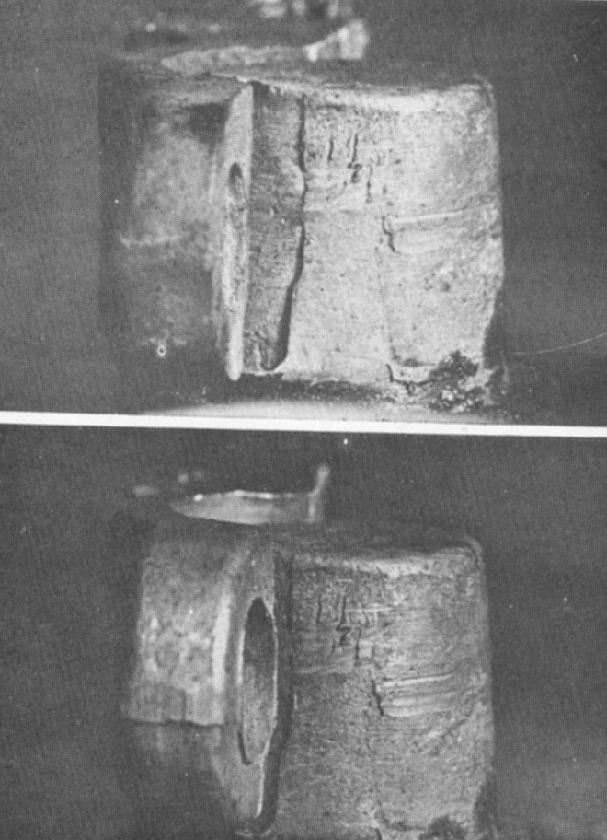
now
Contact marks on Battery Terminals
before
ranbsingh

Slide 28
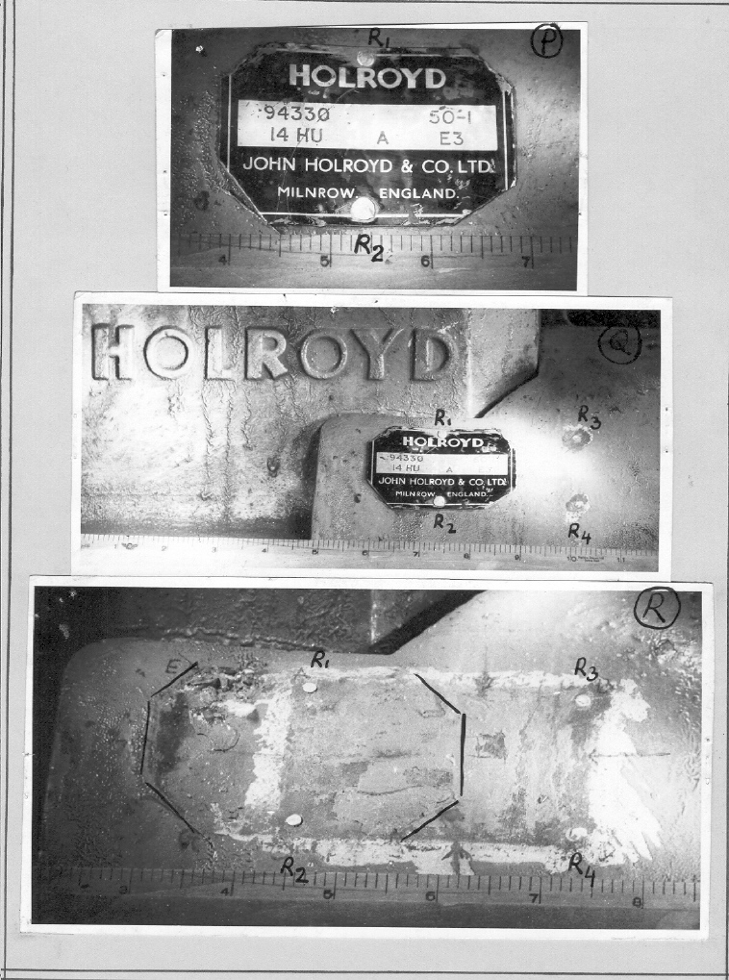
Contact
mark
ranbsingh

Slide 29
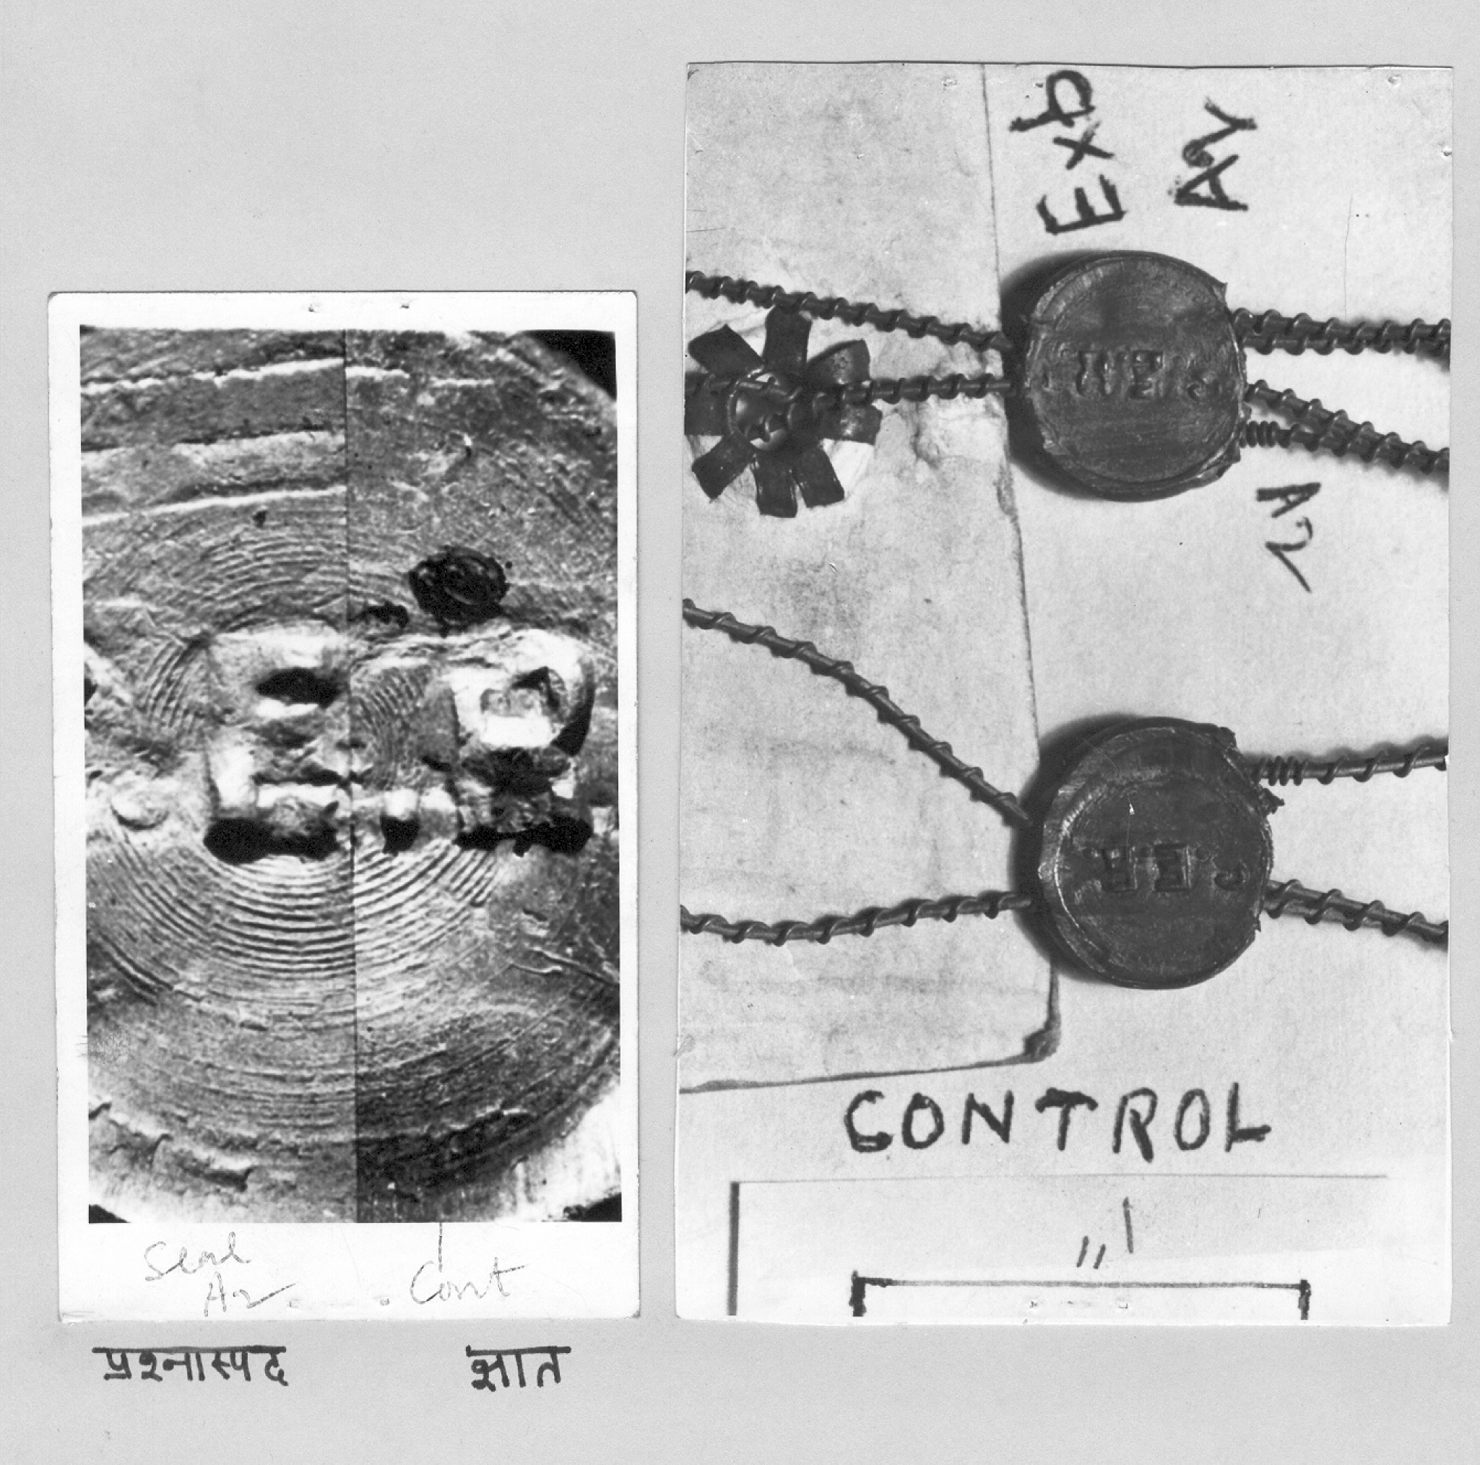
Questioned Known
Microscopic examination of metal seal
Physical examination of metal seal
ranbsingh

Slide 30
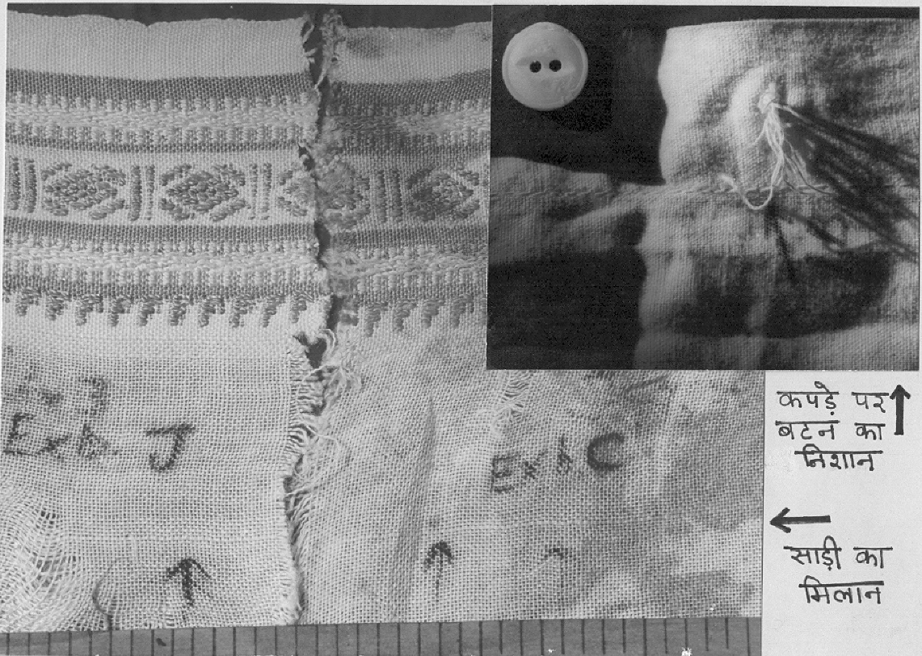
Button
impression
on shirt
Comparison
of saree
pieces
ranbsingh

Slide 31
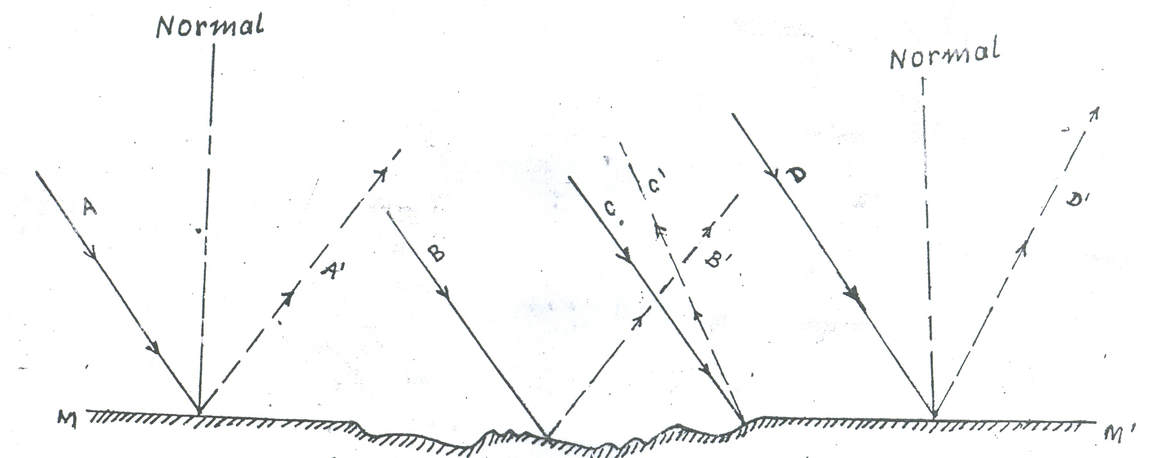
The visual matching of t he evidence mark and the test mark
under a comparison microscope is influenced significantly
by the skill of the examiner. The concept of contour analysis
is crucial to tool mark comparisons because a series of striations
possesses more information than ‘lines’ which may be matched
utilizing a comparison microscope.

Slide 32
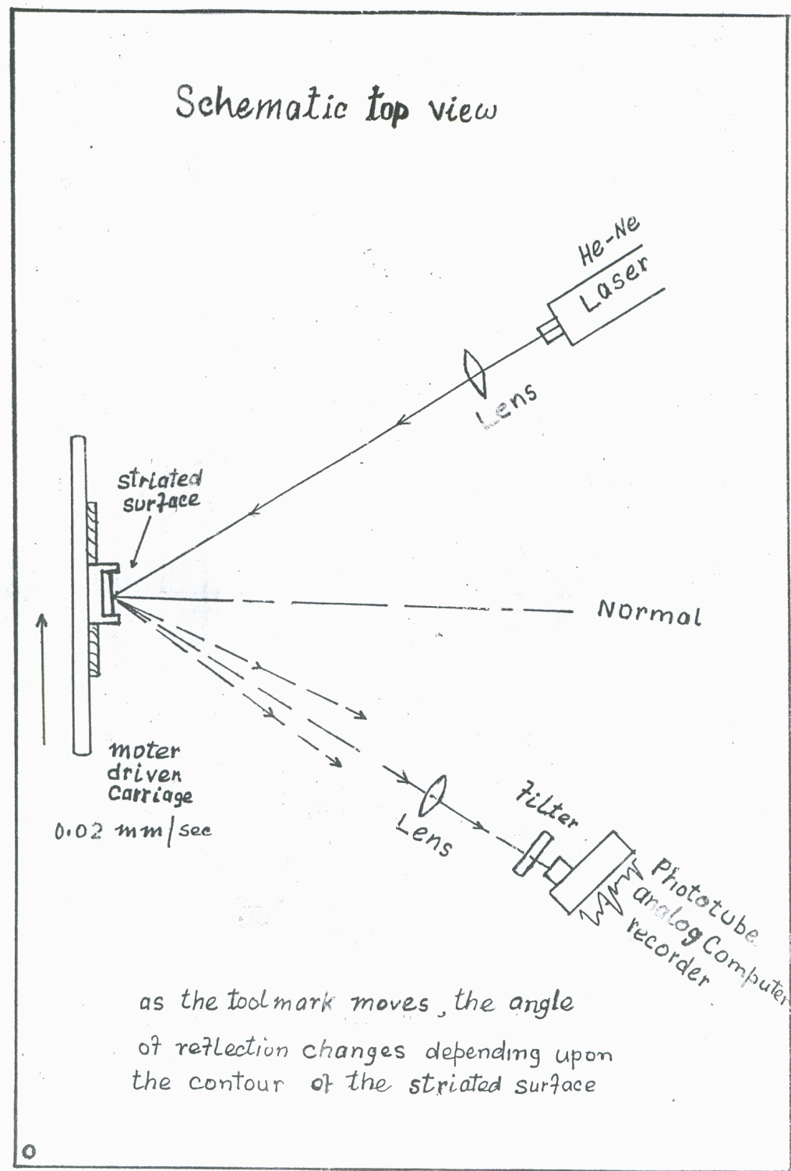
Schematic view
as the tool mark moves,
the angle of reflection
changes depending upon
the contour of the striated
surface

Slide 33
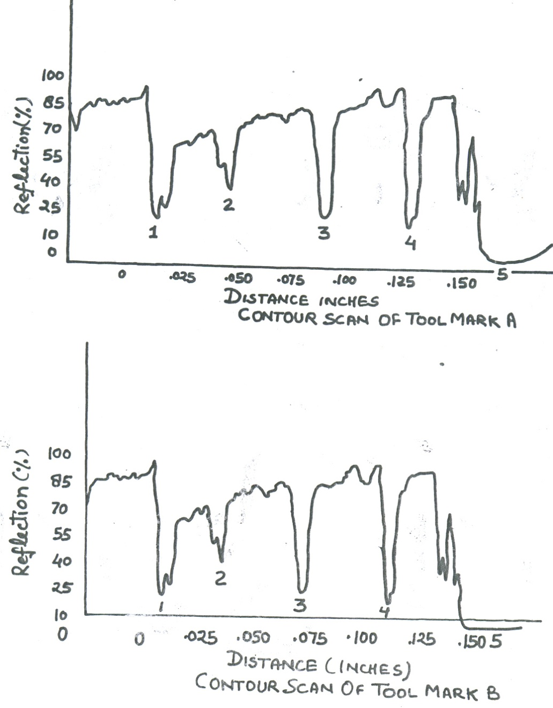
Contour scan of tool mark A
reflection (%)
distance in inches
Contour scan of tool mark B
reflection (%)
distance in inches

Slide 34
THANK YOU

